Slide 1


MOAA Presentation 06/25/2023
“Creating Hope”
Researching Moral Compass, Moral
Distress, Moral Injury in Veterans
Barrington Rotary Club 06/08/2023
John P. Bair, Ph.D., Colonel Chris O’Donnell, U.S.S. Marine Retired,
Katherine Nimrod, MA. Pastoral Counselor
Notes:
Objectives
Participants will know the characteristics of perpetration-based and betrayal-based moral injury.
Participants will know two approaches to healing individuals with moral injury.
Participants will understand the overview of moral injury and bio-psychosocial interventions and treatment.
Participants will know the difference between PTSD, Traumatic Loss, and Moral Injury.
Become more informed about moral injury studies previously completed and currently in process at FHCC.
Learn from Veterans about their experiences related to moral injury treatment.

Slide 2
DSM-5 Criteria for PTSD
A. Exposure to one or more traumatic event(s)
B. Intrusion symptoms associated with the traumatic event(s) (1+)
C. Persistent avoidance of stimuli associated with the traumatic event(s) (1 or 2)
D. Negative alterations in cognitions and mood that are associated with the traumatic event(s) (3+)
E. Alterations in arousal and reactivity that are associated with the traumatic event(s) (3+)
American Psychiatric Association. (2013). Diagnostic and statistical manual of mental disorders (5th ed.). Arlington, VA: American Psychiatric Publishing.
Notes:
A. Actual/threatened death, serious injury, OR sexual violation
Direct experience or witnessing in person as they occurred to others.
Learning it occurred to a close relative or close friend, which was violent or accidental
Experiencing repeated or extreme exposure to aversive details of the event(s) (
B. Intrusion- Random/cued recurrent, distressing memories/ dreams,, flashbacks, intense or prolonged distress at exposure to internal/external reminders
- Marked physiological reactions to reminders of the traumatic event(s).
C. Persistent avoidance of stimuli that arouse memories (began after event(s)- efforts to avoid one or both --- internal reminders (thoughts, feelings, or physical sensations) and/or
External reminders (ppl, places, convs, activities, objects, situations)
D. Negative alterations in cognitions and mood (began or worsened after event(s)
Can’t remember an important aspect of the event(s)
- Persistent and exaggerated negative expectations about one’s self, others, or the world.
- Persistent distorted blame of self/ others about the cause or consequences of event(s).
- Pervasive negative emotional state (for example, fear, horror, anger, guilt, or shame).
- Markedly diminished interest or participation in significant activities.
- Feeling detachment or estrangement from others.
- Persistent inability to experience positive emotions (e.g., unable to have loving feelings, psychic numbing).
E. Alterations in arousal and reactivity… began or worsened after event(s)– irritability/aggressive bx, reckless or self-destructive behavior.
- Hypervigilance, Exaggerated startle response.
- Problems with concentration, Sleep disturbance

Slide 3
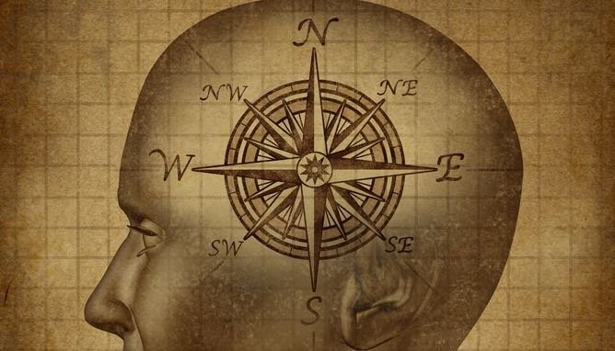
MORAL COMPASS
MORAL COMPASS

Slide 4
Moral Development.
Family Influences, Religious involvement, Schools, Special Groups, Community Groups like
Rotary, YMCA/YWCA, Activities from sports and music to scouting.
**A compass is a relatively simple instrument based on a simple concept. Our picture evokes a clear image of mental processes that point a person in a particular direction in life.
**A personal and social Moral Compass provides a direction through complex ethical challenges enabling leaders with the moral courage to stand for what is right
** We all have to make decisions on a daily basis based on your values, ethics and morals. If our values, ethics and morals are corrupted we feel distress. Severe incidents or accumulation of distress May lead to Moral Injury
** leaders with a faulty moral compass may succeed in the short terms but in a matter of time they falter. Goodness Prevails in the long run.
** When Moral Compass and erosion of values are unspeakable we have a threat to both society at large by accumulated anger and self - other condemnation. The pressures to survive in the distress of war as well as the current array of complex, conflicting economical, social and political forces threaten Moral Compass.

Slide 5
Moral Injury Examples Among Veterans
The most common instances occur when military personnel wound and kill innocent civilians during a raid.
Perpetrating sexual violence or observing sexual violence by fellow troops.
Observing violence or sexual violence by “allied” troops.
Artillery, bombing, napalm, indiscriminate killing, and perpetration.
Friendly fire and killing own troops.
Torture.
Desicrations
Hiding/avoiding combat while peers are under fire
Notes:
27 years ago Client worked on overrun and shooting friends in the night
25 years ago Client worked on stomping a civilian to death….. He later suicided by friend who gave him OD….
20 years ago a Sgt. Major told she had participated in Party that was extreme…. Depression, condemnation and later suicide
Vet who was beaten, tortured, raped in Long Bin began tx and after 18 years of individual tx is now in a group.
SDTU Vet x 2 hit wife and killed her and is locked up for life
6. Vet with abuse, TBI, and tormented by wife hung himself. TX session then with family.
Battle of Di Do and killed enemy with shovel. Officer and Ph.D. bit up wife and now locked up.
Blacks rape white GI and Blacks raped by whites.
10. Vet with cognitive disorder…..fund out he was in Ashau Valley of death as machine gunner

Slide 6
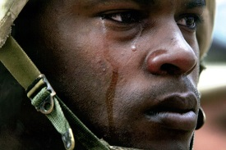
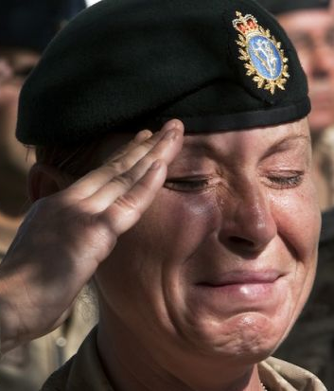
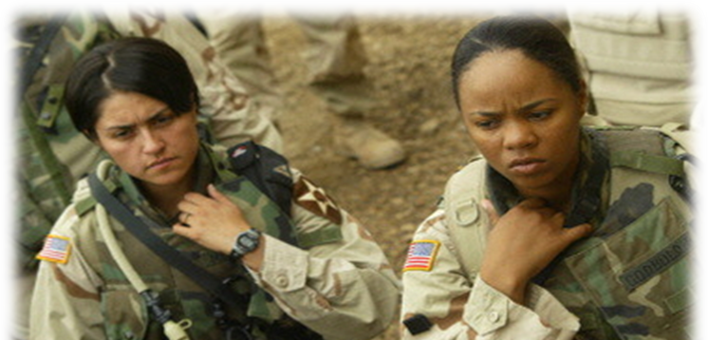

Slide 7
Lovell Research Team: PTSD/Moral Injury/TBI
John P. Bair, Ph.D., Bharathi Swaminathan MD., Dannielle Ciccone-Coutre, Psy.D., Sajoy Varghese, MD.,
Kate Nimrod, MA., Emily A. Sproule, Psy.D.
  1. Beginning 2012
  2. 8 Completed Studies
  3. 2 Active Studies
  4. 2 in-Preparation Studies
  a. Kyneurinine
  b. Eyetracking
  Total: 12
Notes:
The Vital Importance of Research: ISTSS, APA, APA Technology
Grant Funded Research Lab
6 Medium Grants and 3 current submissions: 2 medium and one l large NIMH Grant
2 eyetracking studies, one marriage study and 3 Moral Injury studies
1 eyetracking, 4 TBI, 2 neuroscience, 1 treatment
1 Psycho education, 2 Treatment, 1 Marriage, 2 neuroscience
d. 1 Biochemical, 3 treatment

Slide 8
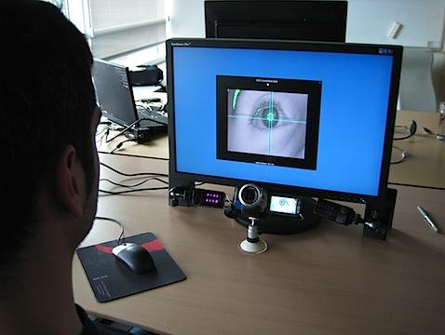
Eye-Tracking
What is Eye-Tracking?
Eye-Tracking is an established methodology for:
  ADD/ADHD
  Autism
  Schizophrenia
  Dyslexia
  Alzheimer's

Slide 9
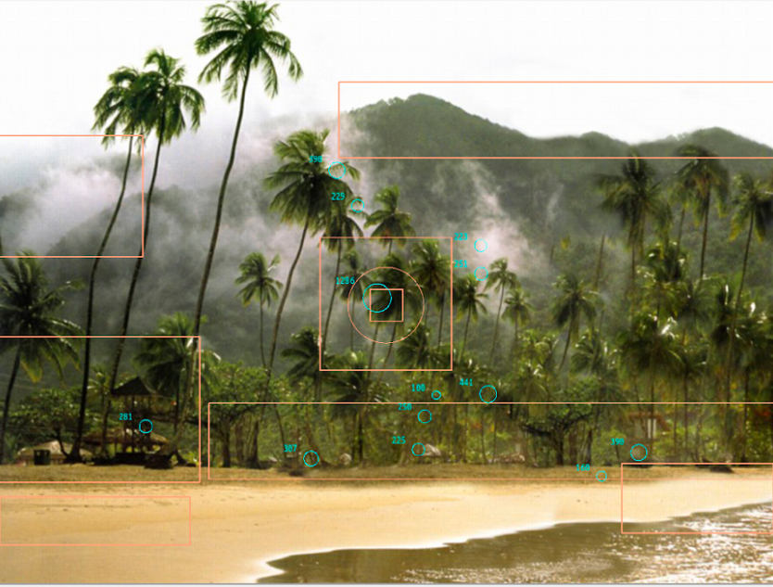
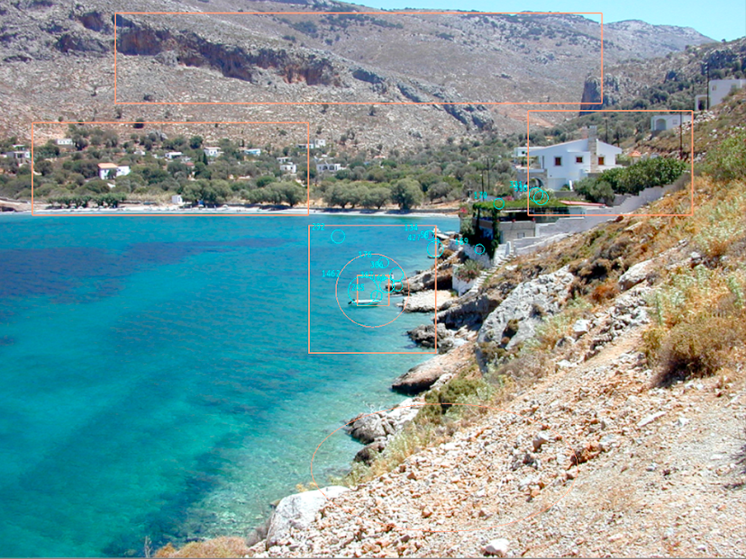

Notes:
Here’s a better look at the eye tracking task.
Eye tracker (left corner) Non-invasive, with 2 PCs (data collection, stimuli presentation)
Sit comfortably at a certain distance from the display screen.
Head support with desktop mount eye tracking camera, set right below display screen and adjusted as needed to correctly align with the eyes within the standard distance.
Dominant eye was selected and camera recorded eye movements in monocular tracking mode. This ensured data was more accurate and also avoids the bias of looking at the image with two eyes.
Collected data- measures of fixation and dwell time to interest areas and non-interest areas across all trials.
International Affective Picture System (IAPS) (U. of Florida Ctr for Emotion & Attn)
SET of ~1000 standardized, emotionally-evocative, color pictures that’s been widely used as stimuli in studies of emotion and attention. Pics range from everyday objects/scene/landscapes − to very are or exciting scenes (eg mutilated bodies, erotic nudes)
Images in general are intended to evoke emotions of pleasure/ arousal/ dominance, with affective ratings of positive, negative, or neutral
30 neutral non-threatening images were purposefully selected to ensure there was no obvious display of threat or trauma-related stimuli (i.e., people, infants/children, animals, vehicles).
Also wanted to reduce the chance of any confounding PTSD-related responses (i.e., flashbacks) that could influence the results.
Images assumed ambiguous since there was no real threat present in the scene BUT there it was possible that the veteran could still perceive a threat (e.g., foggy meadow).
Stimulating pictures = possible elements of a combat setting (e.g., beach with palm trees, seaside with mountain ridges, foggy meadow) vs non-stimulating = everyday elements of nature (e.g., lake view with flowers, tree leaves).
images were presented serially in an alternating order such that the first image was non-stimulating followed by an image of stimulating elements, and so forth.
NOTE: The top two pictures show the interest areas selected on the idea that there’s SOME resemblance to real-life combat settings in which combat Veterans with PTSD would more likely perceive those elements as traumatic reminders even in the absence of an overt trigger (or threat).

Slide 10
Six Steps to Self Forgiveness
Worthington (2012)
Step 1: Receive God’s Forgiveness.
Step 2: Repair Relationships.
Step 3: Rethink Ruminations.
Step 4: REACH Emotional Self-Forgiveness.
Step 5: Rebuild Self-Acceptance.
Step 6: Resolve to Live Virtuously.

Slide 11
Personal Accounts
Sargent. James Rinehart, Retired
Followed by Questions/Discussion

Slide 12
References
* Bair, J. P., & Long, M. (2013). Critical issues in the evolving diagnosis of PTSD. In M. Goldstein (Ed.), The Handbook of Forensic Sociology and Psychology (pp. 201-214),
New York: Springer.
Elliott, R., & Timulak, L. (2021). Essentials of Descriptive-Interpretive Qualitative Research: A Generic Approach. Washington DC: APA Press.
Flake, J.K., Davidson, I.J., Wong, O. Pek, J. (2022) Construct Validity and the Validity of Replication Studies: A Systematic Review. American Psychologist, Vol. 77, No. 4, pp 576 – 588.
Laubmeier, K., Zakowski, S, & Bair, J. P. (2004). Spirituality, coping, and perceived life threat in the psychological adjustment to cancer. International Journal of Behavioral Medicine,11(1), 48-55.
Bair, J. P., & Hostetler, B. (2020). Symptom presentation of guilt, shame, and hyperarousal among PTSD Veterans. Rosalind Franklin University and Lovell FHCC
Medical Grand Rounds, North Chicago IL.
Bair, J. P., & Schimsa, C. (2018). Investigation of pre-war worldviews among morally injured veterans. James A. Lovell FHCC, Medical Grand Rounds Presentation, North Chicago, IL.
Banister, J., Colvonen, P., Angkaw, A., Norman, S. (2019) Differential Relationships of Guilt and Shame
on Post Traumatic Stress Disorder Among Veterans. Psychological Trauma: Theory, Research, Practice, and Policy. Vol. 11, No. 1. 35-42.
Battles, A. R., Jinkerson, J., Kelly, M., Mason, R., (2021). Structural examination of moral injury and
PTSD and their associations with suicidal behavior among combat veterans. Journal of Community Engagement and Scholarship.
Elliot, R & Timulak, L. (2021) Descriptive-Interpretive Qualitative Research, APA Books
Garret, T. & Hayfield, N. (2021) Essential of Theme Analysis, APA Books
Lieberman, S. (2021). Reported in “The Hill”, 11/19/2021.xc
Hebert, J. (2018). A hermeneutical discourse analysis of Moral Injury: Investigating the individual interpretive process. The International Society for
Traumatic Stress Studies (ISTSS), poster presentation, Washington DC.
Hoge, C.W. Grossman, SH., Auchterlonie J.L., Riviere, L.A. Milliken, C.S., & Wilk, J.E. (2014) PTSD treatment for soldiers after combat deployment: Low deployment of mental health care and
reasons for dropout. Psychiatric Services, 65(8), 997-1004 https://doi.org/10.1176/appi.ps201300307
Jinkerson, J. (2016). Defining and assessing moral injury: a syndrome perspective. Traumatology. Vol. 22,
No.2, 122-130. http://dx.dot.org/10.1037/mm000069
Kahneman, D., Sibony. O., Sunstein, C. (2021) Noise: A Flaw in Human Judgment, Hachette Book Group, New York, New York
Lancaster, S., & Miller, M. (2018, December 18). Moral decision making, religious strain, and the experience of moral injury. American Psychological Association. https://doi.org/10.31234/osf.io/dz7ev
Lieberman, M. D., Eisenberger, N. I., Crockett, M. J., Tom, S. M., Pfeifer, J. H., & Way, B. M. (2007).
Putting feelings into words: affect labeling disrupts amygdala activity in response to affective
stimuli. Psychological Science, 18(5), 421–428.
Litz, B., & Carney, J. R. (2018). Employing loving-kindness meditation to promote self- and
other-compassion among war veterans with posttraumatic stress disorder. Spirituality in Clinical
Practice, 5(3), 201-211.
Nature Editorial (2022) Support Europe’s bold vision for responsible research assessment. Nature
Nguyen, D., Bair, J. P., & Ciccone, D. (2020). Eyetracking in the assessment of executive
judgment in PTSD Veterans. The International Neuropsychology Society, Tucson AZ.
Editorial, July.
Paul, A. (2021) The Extended Mind: the power of thinking outside the brain. Houghton Mifflin,
Harcourt, Boston and New York.
Perez, D., Larson, P. Bair, J. (2021) U.S. Veterans Experience Moral Injury Differently Based on Moral
Foundations Preferences, Journal of Community Engagement and Scholarship (JCES).
Siling, J. L., Truss, K., Philips, L., Eastwood, O., Bendall, S. (2021) Young people’s journeys of recovery
from trauma: a qualitative study of narratives from internet forums. Psychological Trauma:
Theory, Research, Practice, and Policy, vol 13, No. 3, p 294 – 296.
Sinatra, G., & Hofer, B. (2021). Science Denial: Why it happens and what to do about it. Oxford
University Press.
Sproule, E. (2022), The Impact of Moral Injury and Moral Distress on Spirituality: A Military
Perspective. ProQuest.
Van der Kolk, B. (2015) The Body Keeps the Score: Brain, Mind, and Body in the Healing of Trauma.
Penguin Publishing.

Slide 13
Kahneman, D., Sibony. O., Sunstein, C. (2021) Noise: A Flaw in Human Judgment, Hachette Book Group, New York, New York
Lancaster, S., & Miller, M. (2018, December 18). Moral decision making, religious strain, and the experience of moral injury. American Psychological Association. https://doi.org/10.31234/osf.io/dz7ev
Lieberman, M. D., Eisenberger, N. I., Crockett, M. J., Tom, S. M., Pfeifer, J. H., & Way, B. M. (2007).Putting feelings into words: affect labeling disrupts amygdala activity in response to affective
stimuli. Psychological Science, 18(5), 421–428.
Sinatra, G., & Hofer, B. (2021). Science Denial: Why it happens and what to do about it. Oxford
University Press.
Sproule, E. (2022), The Impact of Moral Injury and Moral Distress on Spirituality: A Military
Perspective. ProQuest.
Van der Kolk, B. (2015) The Body Keeps the Score: Brain, Mind, and Body in the Healing of Trauma.
Penguin Publishing.

